Slide 1

A Responsabilidade Civil do Transportador Aéreo à luz das decisões do STF:
O Tema 1.366 da RG
Junho de 2025
Márcia Almeida para SBDA

Slide 2
1929 – Warsaw Convention
Brazil ratified the Warsaw Convention, establishing rules for international air carriage, including cargo liability.

Slide 3
1955 – Hague Protocol
Brazil adopted the Hague Protocol, which amended the Warsaw Convention to modernize liability rules.
Introduction of the application of the SDR;

Slide 4
1961 – Guadalajara Convention
Supplemented the Warsaw Convention by clarifying the role of contracting and actual carriers.

Slide 5
1999 – Montreal Convention
Brazil signed the Montreal Convention, which unified and replaced much of the Warsaw system, including updated liability limits and procedures for cargo claims.

Slide 6
2006 – Entry into Force of Montreal Convention in Brazil
The Montreal Convention officially entered into force in Brazil on 28 September 2006. However, its application was inconsistent in courts for several years.

Slide 7
2009 – STF Decision Favoring Consumer Code
The Supreme Federal Court (STF) initially ruled that the Brazilian Consumer Defence Code (CDC) could override international conventions in aviation disputes, including cargo claims.

Slide 8
May 2017 – STF Reversal (Air Canada & Air France Cases)
Landmark rulings by the STF reversed the 2009 stance, affirming that international conventions take precedence over the CDC in international air carriage cases.

Slide 9
Tema 210 (2017)
Tese: “Nos termos do art. 178 da Constituição da República, as normas e os tratados internacionais limitadores da responsabilidade das transportadoras aéreas de passageiros, especialmente as Convenções de Varsóvia e Montreal, têm prevalência em relação ao Código de Defesa do Consumidor. O presente entendimento não se aplica às hipóteses de danos extrapatrimoniais.” (2023)

Slide 10
April 2018 – STJ Applies Montreal Convention to Cargo Claims
The Superior Court of Justice (STJ) ruled that the Montreal Convention applied to a subrogated cargo claim by an insurer, rejecting the application of the CDC and Civil Code.
However, the issue remained dubious with the STF, in particular in relation to cargo insurers

Slide 11
ARE 1372360 - ED-AgR-EDv-AgR) Feb 2024
Julgamento de agravo regimental apresentado nos Embargos de Divergência no Recurso Extraordinário com Agravo (ARE 1372360 ED-AgR-EDv-AgR) - STF Forma maioria sobre entendimento a respeito da aplicação de Montreal para casos de transporte de carga, inclusive em ações de regresso de seguradoras sub-rogadas.
As normas e os tratados internacionais limitadores da responsabilidade das transportadoras aéreas de passageiros, especialmente as Convenções de Varsóvia e Montreal, têm prevalência em relação ao Código de Defesa do Consumidor.

Slide 12
Tema 1366 - Feb 2025
Tese Firmada pelo STF:
1ª Tese: A pretensão indenizatória por danos materiais em transporte aéreo internacional está sujeita aos limites previstos em normas e tratados internacionais firmados pelo Brasil, em especial as Convenções de Varsóvia e de Montreal.
2ª Tese: É infraconstitucional e fática a controvérsia sobre o afastamento da limitação à pretensão indenizatória quando a transportadora tem conhecimento do valor da carga ou age com dolo ou culpa grave.

Slide 13
2010–Present – Liability Limit Updates & Ongoing Judicial Adaptation
Although the Montreal Convention's liability limits were updated in 2010, Brazilian courts have been slow to internalize these changes. Courts often still refer to the original Portuguese version of the Convention. Updates to the limit were not yet internalised.

Slide 14
Implications
Strengthens legal certainty for international carriers operating in Brazil. Predictability and uniformity
Limits the application of the Consumer Defense Code (CDC) in international cargo cases.
Aligns Brazil’s jurisprudence with international standards, reinforcing treaty obligations.
Reduced litigation Costs.
Global Competitiveness

Slide 15
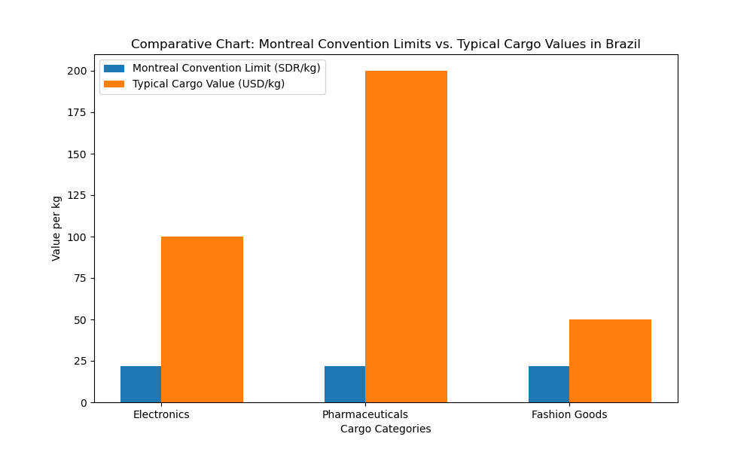
Comarative chart showing the gap between the Montreal Convention's liability limits and the typical cargo values in Brazil across different sectors
The capped compensation (around 22 SDR/kg, roughly $29 USD/kg) often falls short of the actual value of goods like pharmaceuticals and electronics, which can exceed $100–200 USD/kg

Slide 16
Críticas:
. Restriction of Consumer Protection
Critics argue that the decision limits the applicability of the Consumer Defense Code (CDC) in international cargo transport cases. This is seen as a setback for consumer rights, especially for small businesses and individuals who may not have the bargaining power to negotiate terms with large international carriers
Reduced Compensation for Losses
By enforcing strict liability limits from the Warsaw and Montreal Conventions, the ruling may prevent full compensation for actual damages suffered by cargo owners. This is particularly problematic in cases involving high-value goods, where the capped indemnities fall far short of the real losses

Slide 17
Críticas
Complexity in Proving Exceptions
The STF ruled that exceptions to liability limits—such as willful misconduct or gross negligence—are factual and infraconstitutional issues. This means they must be proven in lower courts, which can be procedurally complex and costly, discouraging claimants from pursuing legitimate exceptions
. Favoring International Carriers
Some legal experts argue that the decision tilts the balance in favor of international airlines, reinforcing a system that prioritizes predictability and uniformity over equity and fairness in individual cases

Slide 18
Para os sguradores das empresas aéreas:
Risk Quantification
The Convention’s liability caps allow insurers to accurately assess and price risk, improving the sustainability of underwriting for air cargo policies.
Claims Management Efficiency
Standardized documentation and liability rules streamline claims processing, reducing administrative costs and disputes.
Fraud Mitigation
The Convention’s strict documentation and procedural requirements help reduce fraudulent claims.
Encouragement of Subrogation
Insurers can pursue subrogation claims within a clear legal framework, improving recovery prospects when carriers are at fault.

